Slide 1
St. Louis Central Corridor West Building Permits
Monthly Report: May 2020

Slide 2
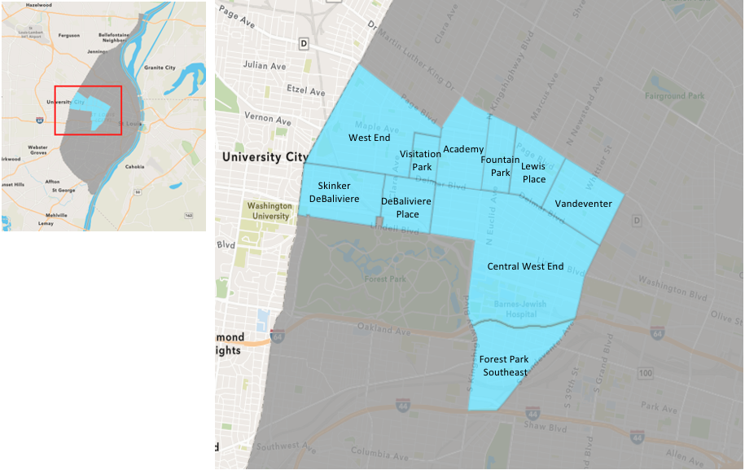
St. Louis Neighborhood Spatial Reference

Slide 3
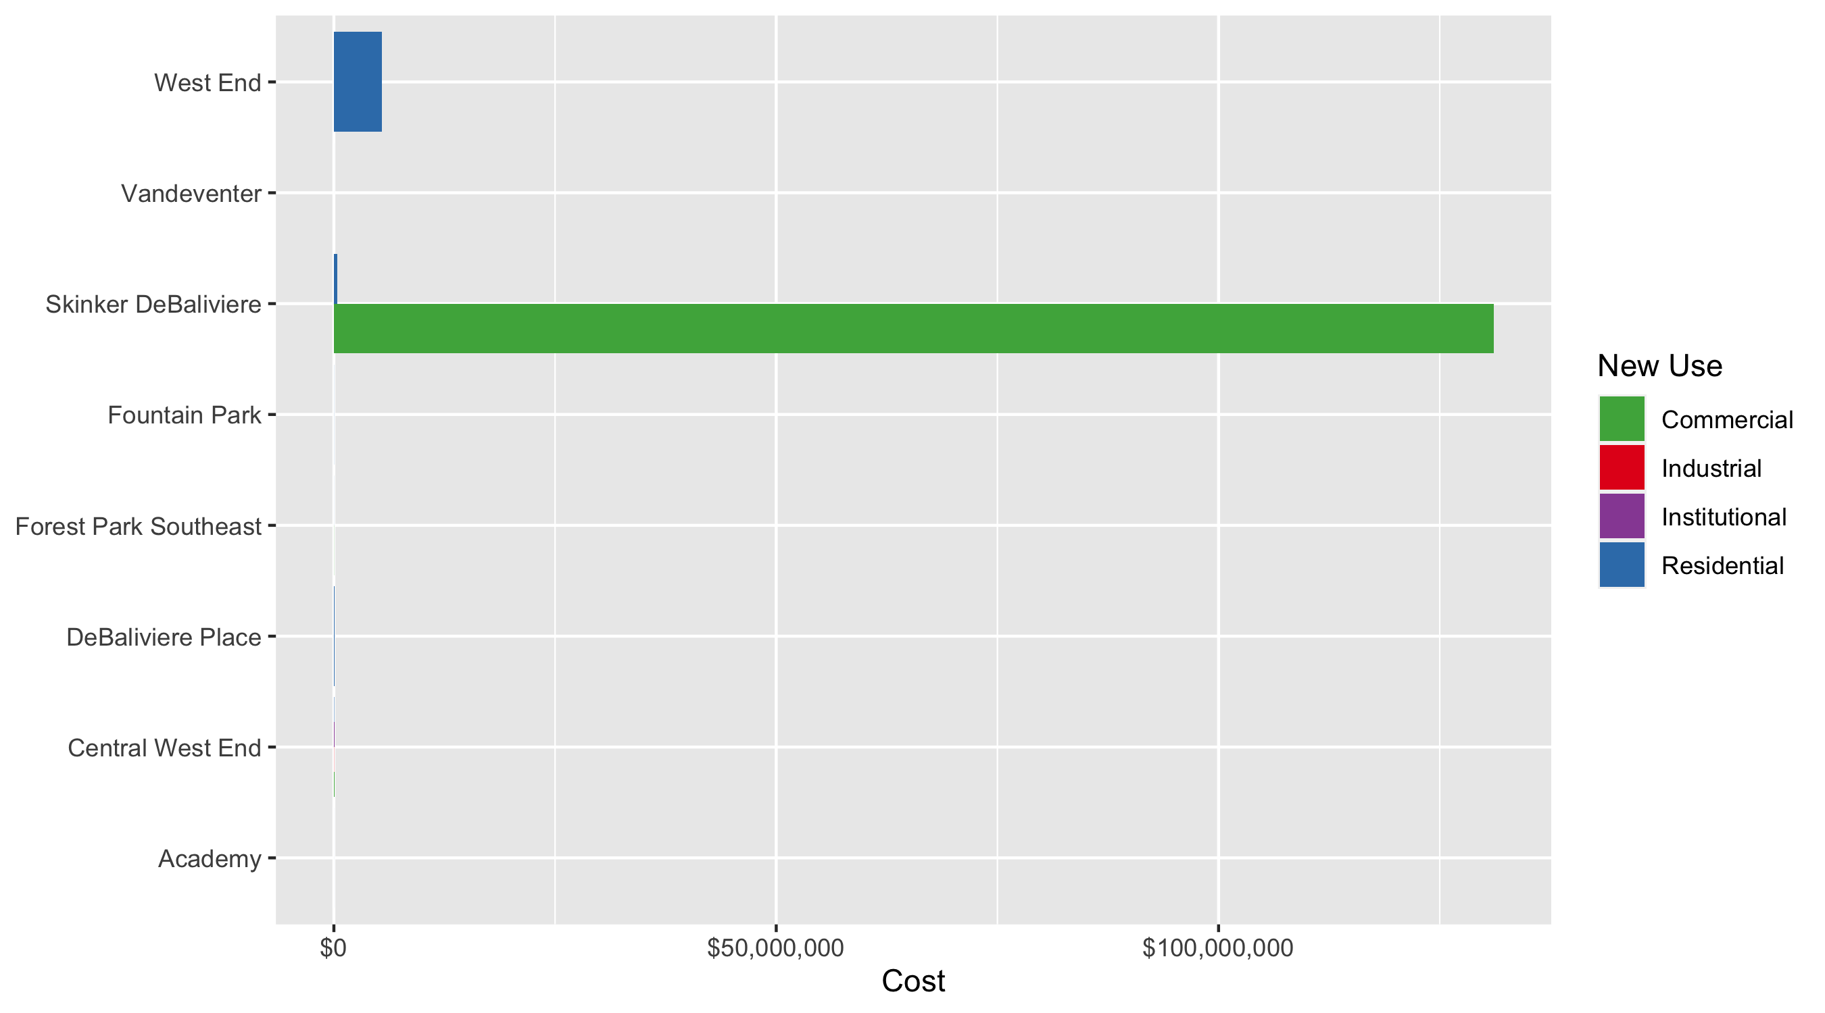
Neighborhood Summary: Average Building Permit Cost

Slide 4
Neighborhood Summary
May 2020 | May 2020 | May 2020 | May 2020
Neighborhood | Average Cost | # of Permits | Total Value of Permits
Academy | $3,200 | 1 | $3,200
Central West End | $50,593 | 37 | $1,871,949
DeBaliviere Place | $62,333 | 6 | $373,999
Forest Park Southeast | $9,590 | 8 | $76,716
Fountain Park | $10,500 | 1 | $10,500
Lewis Place | $0 | 0 | $0
Skinker DeBaliviere | $33,050,561 | 12 | $396,606,735
Vandeventer | $1,350 | 2 | $2,700
Visitation Park | $0 | 0 | $0
West End | $5,423,125 | 2 | $10,846,250
Last 6 Months | Last 6 Months | Last 6 Months | Last 6 Months
Neighborhood | Average Cost | # of Permits | Total Value of Permits
Academy | $76,803 | 17 | $1,305,650
Central West End | $502,506 | 222 | $111,556,362
DeBaliviere Place | $947,426 | 23 | $21,790,799
Forest Park Southeast | $217,359 | 56 | $12,172,106
Fountain Park | $62,700 | 5 | $313,500
Lewis Place | $800 | 4 | $3,200
Skinker DeBaliviere | $6,414,350 | 62 | $397,689,683
Vandeventer | $45,322 | 8 | $362,577
Visitation Park | $14,000 | 1 | $14,000
West End | $583,654 | 41 | $23,929,833

Slide 5
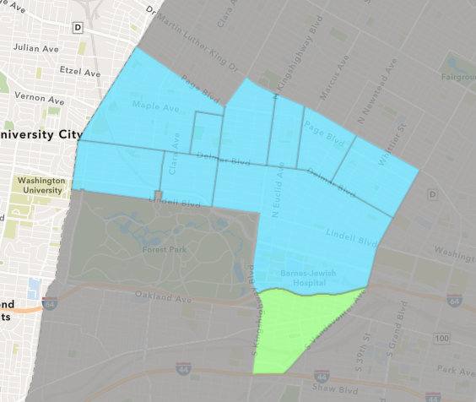
Forest Park Southeast
May 2020 Neighborhood Cost Breakdown
Mean: $9,590
Median: $3,633
Range: $450 - $26,000

Slide 6
Forest Park Southeast: Summary Notes
8 building permits in May 2020
-27.27% change compared to May 2019 (11 total building permits)
$9,590: Average building permit cost in May 2020
-17.08% change compared to May 2019 ($11,565)
48 total building permits in 2020
-38.46% change YTD compared to this time in 2019 (78 total building permits)
$127,077: YTD average building permit cost in 2020
-9.58% change YTD compared to this time in 2019 ($140,536)

Slide 7
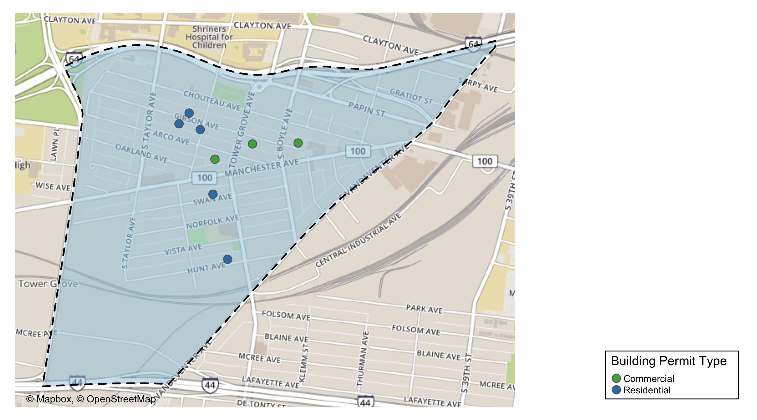
Forest Park Southeast

Slide 8
Neighborhood Summary
May 2020 | May 2020 | May 2020 | May 2020
Permit Use | Average Cost | # of Permits | Total Value of Permits
Commercial | $14,667 | 3 | $44,000
Industrial | $0 | 0 | $0
Institutional | $0 | 0 | $0
Residential | $6,543 | 5 | $32,716
Last 6 Months | Last 6 Months | Last 6 Months | Last 6 Months
Permit Use | Average Cost | # of Permits | Total Value of Permits
Commercial | $271,116 | 16 | $4,337,850
Industrial | $0 | 0 | $0
Institutional | $911,449 | 6 | $5,468,693
Residential | $69,575 | 34 | $2,365,563

Slide 9
Forest Park Southeast Individual Permit Breakdown
Owner | New Use | Cost | address
POPEK, JACOB M | Residential | $4,000 | 4440 GIBSON AV
LONI PROPERTIES CO | Commercial | $15,000 | 4121 MANCHESTER AV
CITY DOGS REALTY LLC | Residential | $1,000 | 4322 VISTA AV
SPENCER REAL ESTATE 763 NORTH LLC | Residential | $3,266 | 4306 MANCHESTER AV
CROSSFACE LLC | Commercial | $26,000 | 4243 MANCHESTER AV
MCNALLY, SHANNON R | Residential | $24,000 | 4455 OAKLAND AV
TROUTS LANDING LLC | Commercial | $3,000 | 4234 GIBSON AV
PRIME PORCH LLC | Residential | $450 | 4412 CHOUTEAU AV

Slide 10
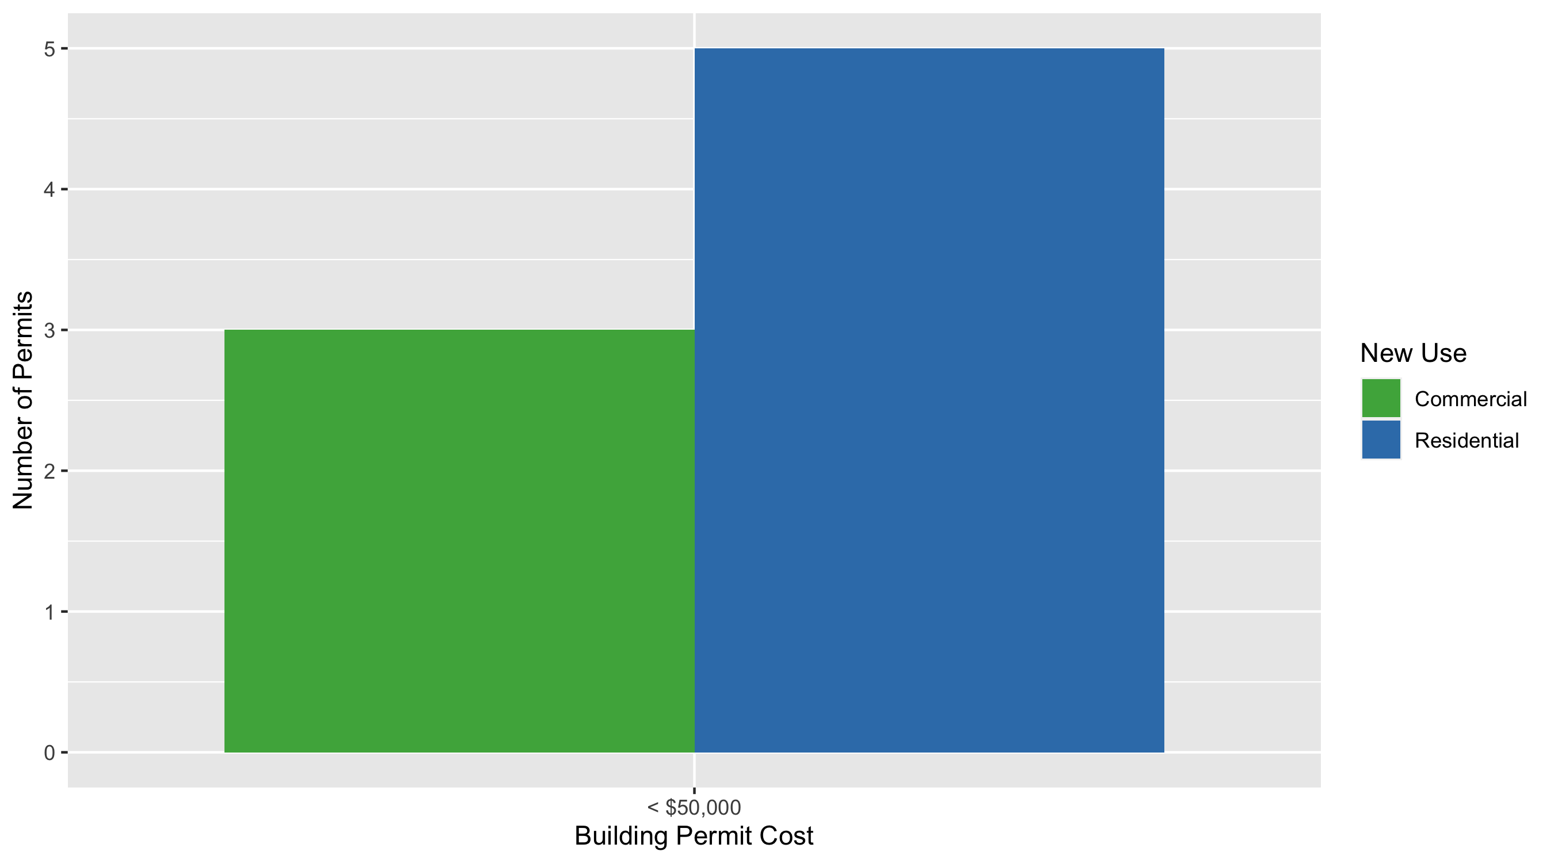
Forest Park Southeast Permit Cost Breakdown

Slide 11
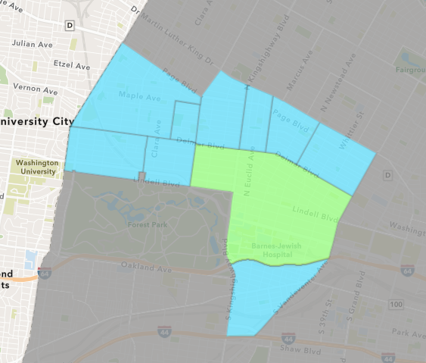
Central West End
May 2020 Neighborhood Cost Breakdown
Mean: $50,593
Median: $25,000
Range: $200 - $550,000

Slide 12
Central West End: Summary Notes
37 building permits in May 2020
-7.50% change compared to May 2019 (40 total building permits)
$50,593: Average building permit cost in May 2020
-48.60% change compared to May 2019 ($98,436)
177 total building permits in 2020
-6.84% change YTD compared to this time in 2019 (190 total building permits)
$491,269: YTD average building permit cost in 2020
110.17% change YTD compared to this time in 2019 ($233,752)

Slide 13
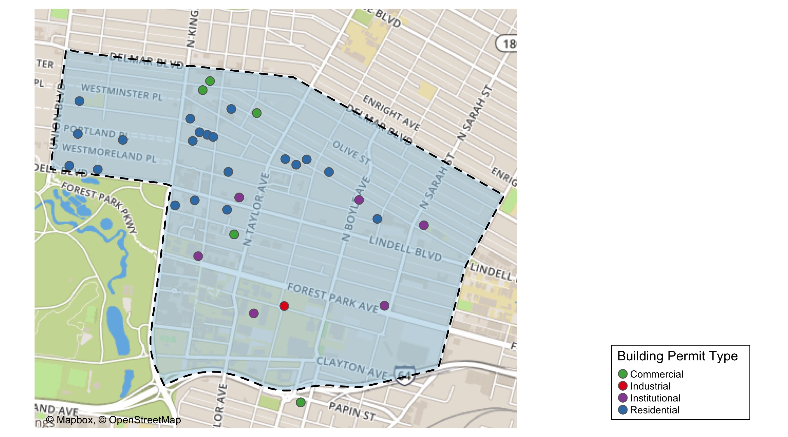
Central West End

Slide 14
Central West End
May 2020 | May 2020 | May 2020 | May 2020
Permit Use | Average Cost | # of Permits | Total Value of Permits
Commercial | $43,584 | 7 | $305,089
Industrial | $20,000 | 1 | $20,000
Institutional | $102,089 | 7 | $714,626
Residential | $37,829 | 22 | $832,234
Last 6 Months | Last 6 Months | Last 6 Months | Last 6 Months
Permit Use | Average Cost | # of Permits | Total Value of Permits
Commercial | $1,110,142 | 32 | $35,524,545
Industrial | $20,838 | 2 | $41,676
Institutional | $926,772 | 76 | $70,434,676
Residential | $49,602 | 112 | $5,555,465

Slide 15
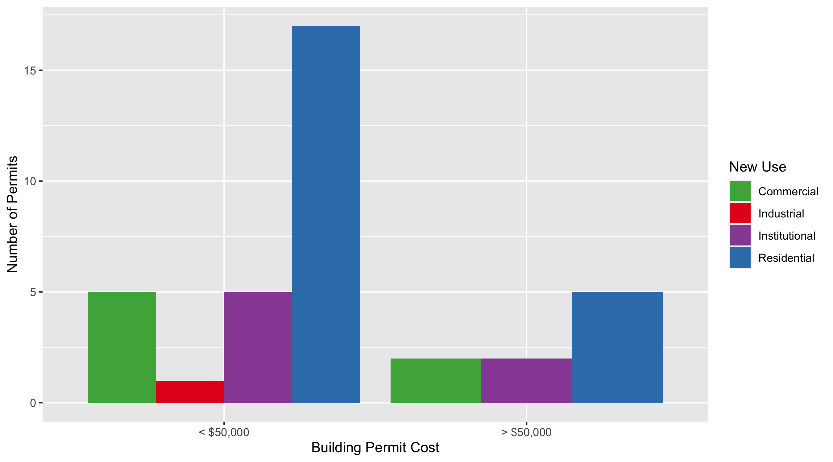
Cental West End Permit Cost Breakdown

Slide 16
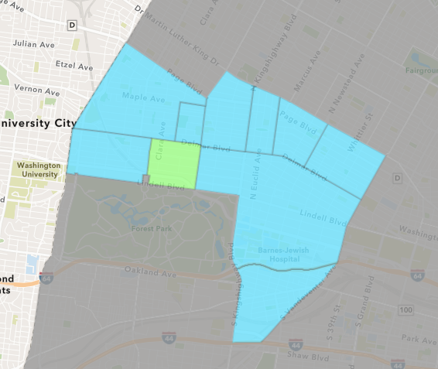
DeBaliviere Place
May 2020 Neighborhood Cost Breakdown
Mean: $62,333
Median: $46,340
Range: $4,300 - $182,351

Slide 17
DeBaliviere Place: Summary Notes
6 building permits in May 2020
50.00% change compared to May 2019 (4 total building permits)
$62,333: Average building permit cost in May 2020
361.10% change compared to May 2019 ($13,518)
20 total building permits in 2020
-23.08% change YTD compared to this time in 2019 (26 total building permits)
$1,077,203: YTD average building permit cost in 2020
1524.87% change YTD compared to this time in 2019 ($66,295)

Slide 18
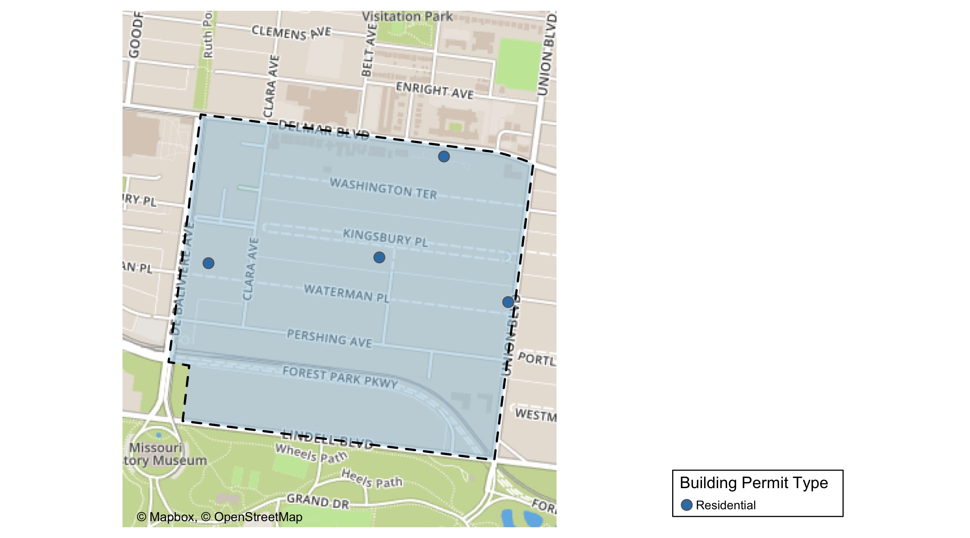
DeBaliviere Place

Slide 19
DeBaliviere Place
May 2020 | May 2020 | May 2020 | May 2020
Permit Use | Average Cost | # of Permits | Total Value of Permits
Commercial | $0 | 0 | $0
Industrial | $0 | 0 | $0
Institutional | $0 | 0 | $0
Residential | $62,333 | 6 | $373,999
Last 6 Months | Last 6 Months | Last 6 Months | Last 6 Months
Permit Use | Average Cost | # of Permits | Total Value of Permits
Commercial | $25,000 | 1 | $25,000
Industrial | $0 | 0 | $0
Institutional | $8,000 | 1 | $8,000
Residential | $1,036,086 | 21 | $21,757,799

Slide 20
DeBaliviere Place Individual Permit Breakdown
Owner | New Use | Cost | Address
WATERMAN-KINGSBURY CONDOMINIUM | Residential | $4,300 | 5696 KINGSBURY AV
HURLEY, MARIA YADIRA & JOHN L PRATER | Residential | $19,669 | 34 KINGSBURY PL
BULLOCK, JAMES R & DAN S | Residential | $182,351 | 13 KINGSBURY PL
BURKE, TIMOTHY ROBERT & | Residential | $30,000 | 1 WASHINGTON TER
BERNSTEIN, CAROLYN | Residential | $62,679 | 39 KINGSBURY PL
RUWITCH, THOMAS E & MELISSA E | Residential | $75,000 | 6 KINGSBURY PL

Slide 21
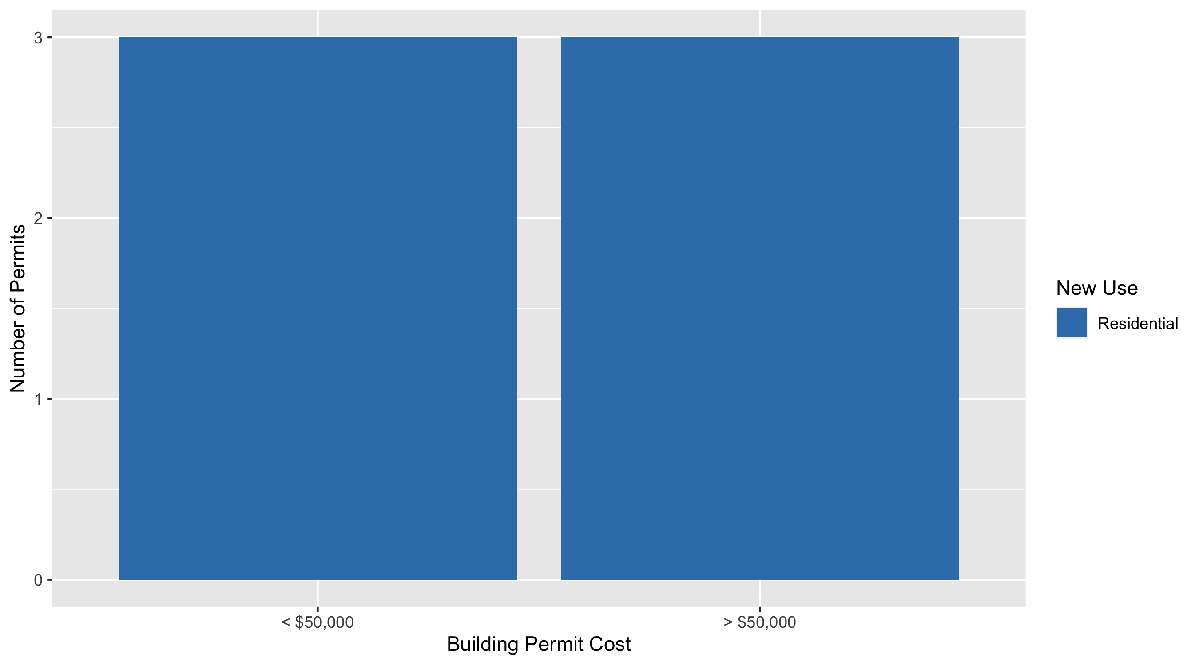
DeBaliviere Place Permit Cost Breakdown

Slide 22
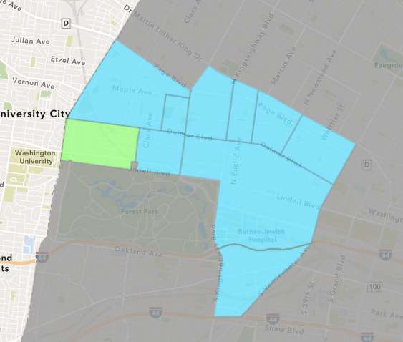
Skinker DeBaliviere
May 2020 Neighborhood Cost Breakdown
Mean: $33,050,561
Median: $79,349
Range: $1,900 - $370,462,221

Slide 23
Skinker DeBaliviere: Summary Notes
12 building permits in May 2020
50.00% change compared to May 2019 (8 total building permits)
$33,050,561: Average building permit cost in May 2020
270515.11% change compared to May 2019 ($12,213)
55 total building permits in 2020
111.54% change YTD compared to this time in 2019 (26 total building permits)
$7,226,885: YTD average building permit cost in 2020
44658.21% change YTD compared to this time in 2019 ($16,146)

Slide 24
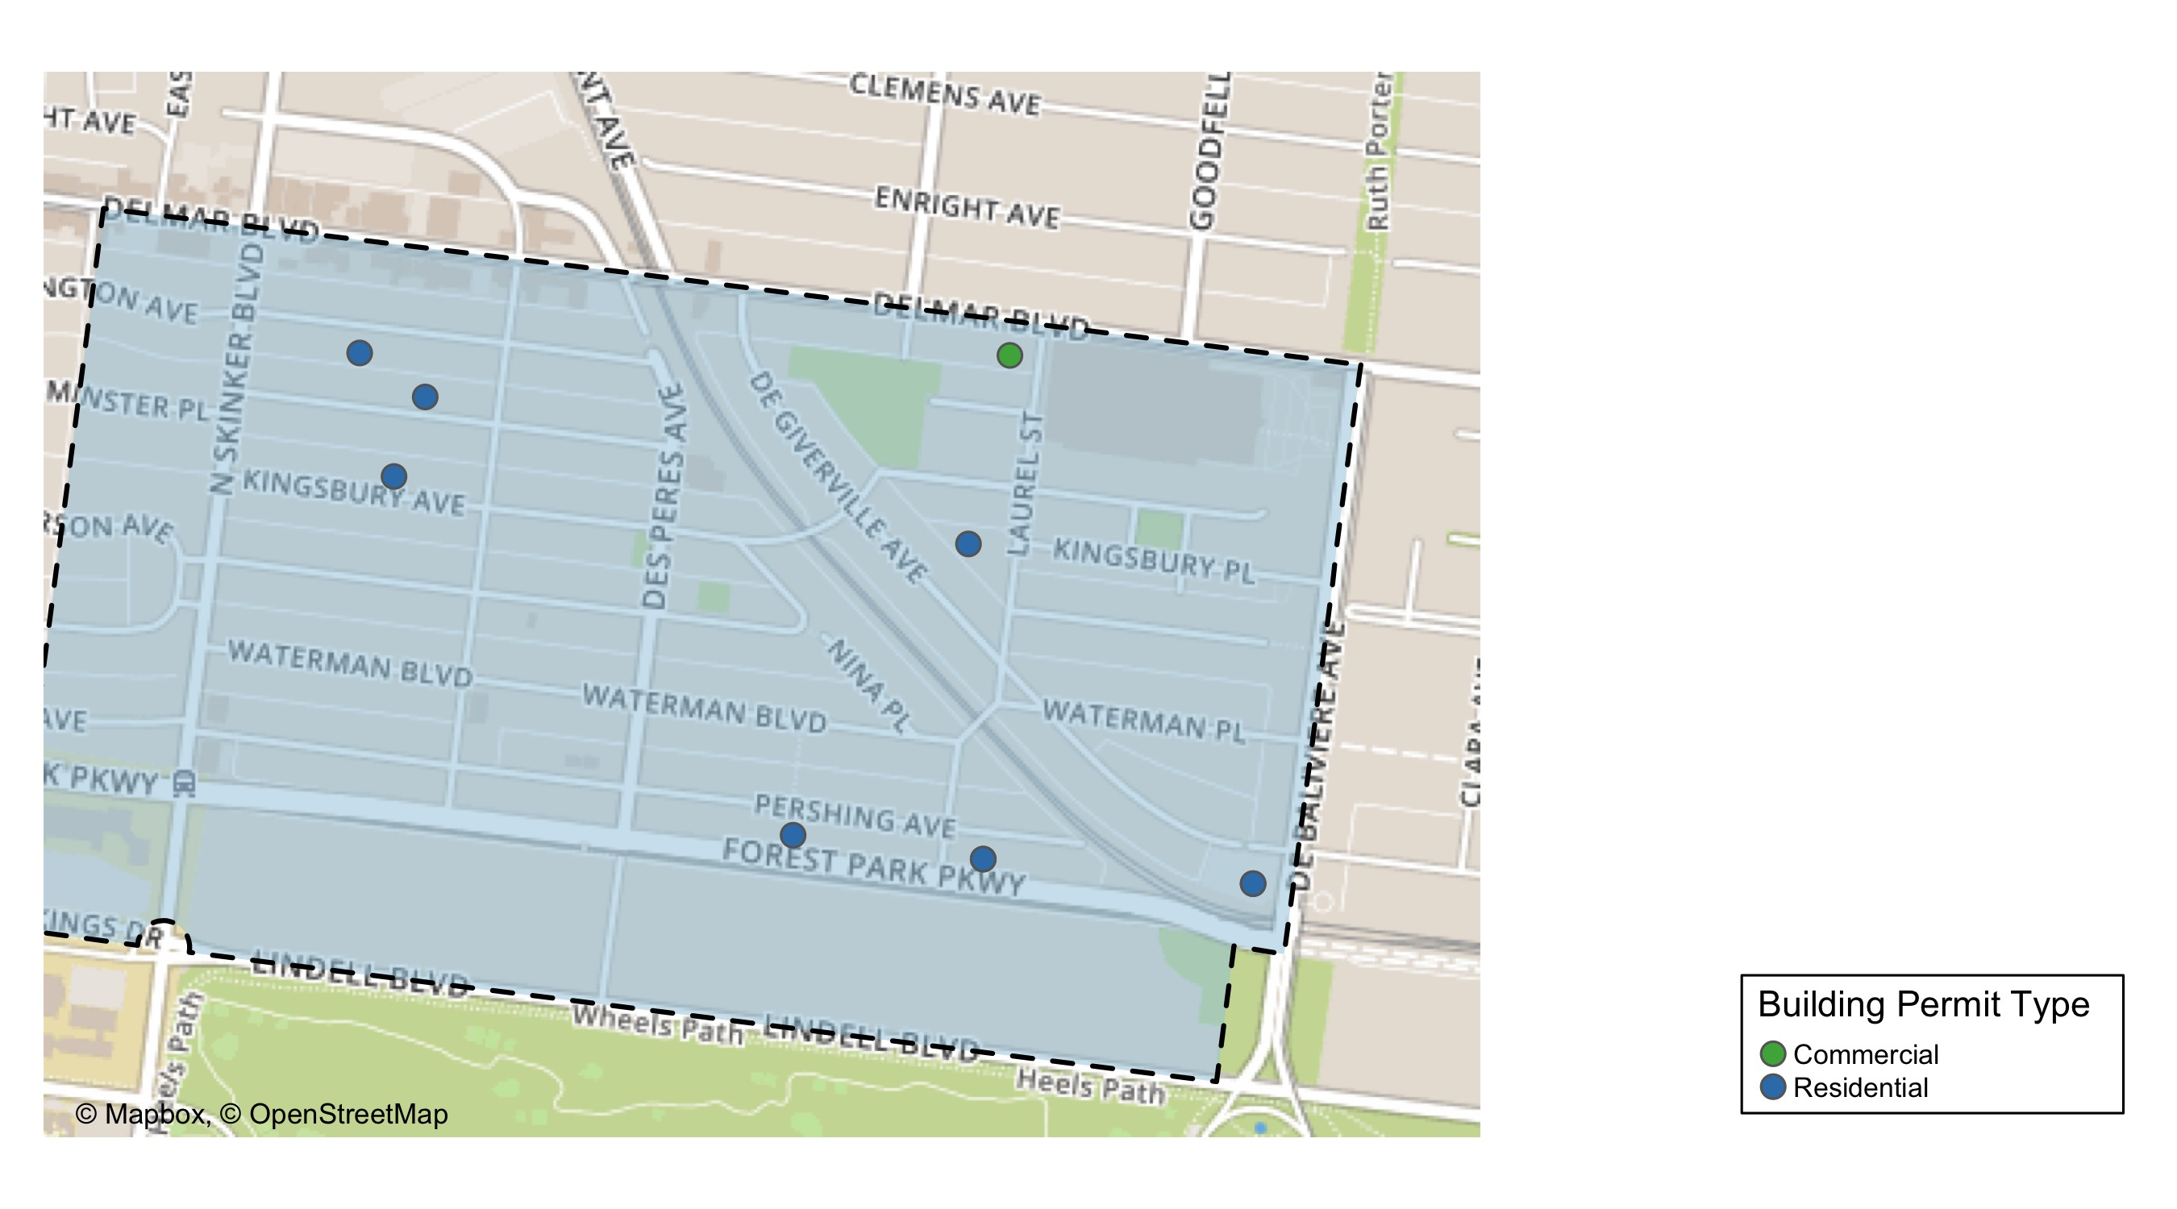
Skinker DeBaliviere

Slide 25
Skinker DeBaliviere
May 2020 | May 2020 | May 2020 | May 2020
Permit Use | Average Cost | # of Permits | Total Value of Permits
Commercial | $131,082,701 | 3 | $393,248,102
Industrial | $0 | 0 | $0
Institutional | $0 | 0 | $0
Residential | $373,181 | 9 | $3,358,633
Last 6 Months | Last 6 Months | Last 6 Months | Last 6 Months
Permit Use | Average Cost | # of Permits | Total Value of Permits
Commercial | $56,185,283 | 7 | $393,296,978
Industrial | $0 | 0 | $0
Institutional | $10,000 | 1 | $10,000
Residential | $81,161 | 54 | $4,382,705

Slide 26
Skinker DeBaliviere Individual Permit Breakdown
Owner | New Use | Cost | Address
BIG BRICK BUILDINGS ML LLC | Residential | $20,700 | 6030 PERSHING AV
BI-STATE DEVELOPMENT AGENCY | Commercial | $370,462,221 | 5720 DEGIVERVILLE AV
DEBALIVIERE COMMUNITY CTR LP | Commercial | $22,355,881 | 301 DEBALIVIERE AV
PAGEDALE CONGREGATION OF | Commercial | $430,000 | 5930 DELMAR BLVD
RON RAMMAHA | Residential | $1,900 | 5948 PERSHING AV
BI-STATE DEVELOPMENT AGENCY | Residential | $1,831,648 | 5720 DEGIVERVILLE AV
DEBALIVIERE COMMUNITY CTR LP | Residential | $1,330,804 | 301-331 DEBALIVIERE AV
RAINEY, TERESA & SHAUN L | Residential | $8,450 | 5830 WESTMINSTER PL
BONAN, F WILLIAM | Residential | $40,000 | 6159 LINDELL BLVD
AYERS, CAMERON & REBECCA | Residential | $3,833 | 6152 WASHINGTON AV
SCHOENFELD, KING & DEANNA | Residential | $2,600 | 6124 WESTMINSTER PL
HESS, ROBERT J & BEATRIZ ANGELICA | Residential | $118,698 | 6175 KINGSBURY AV

Slide 27
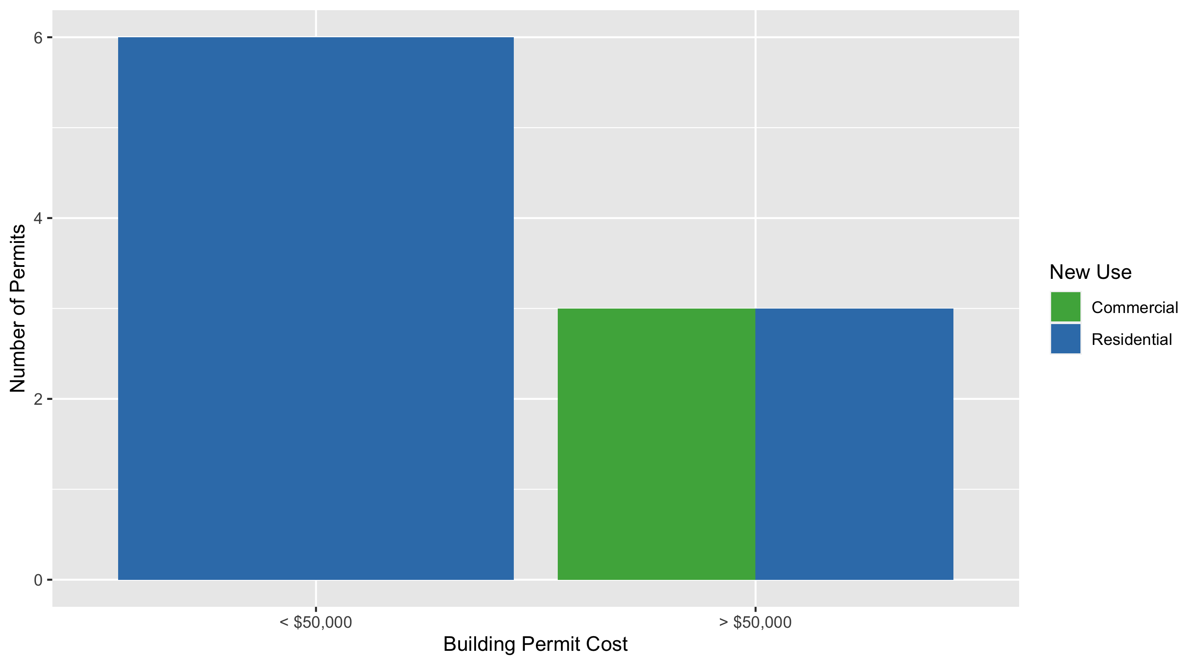
Skinker DeBaliviere Permit Cost Breakdown

Slide 28
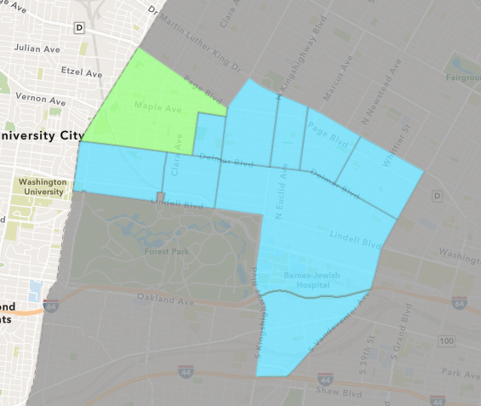
West End
May 2020 Neighborhood Cost Breakdown
Mean: $5,423,125
Median: $5,423,125
Range: $6,250 - $10,840,000

Slide 29
West End: Summary Notes
2 building permits in May 2020
0.00% change compared to May 2019 (2 total building permits)
$5,423,125: Average building permit cost in May 2020
16088.43% change compared to May 2019 ($33,500)
30 total building permits in 2020
114.29% change YTD compared to this time in 2019 (14 total building permits)
$746,922: YTD average building permit cost in 2020
377.22% change YTD compared to this time in 2019 ($156,514)

Slide 30
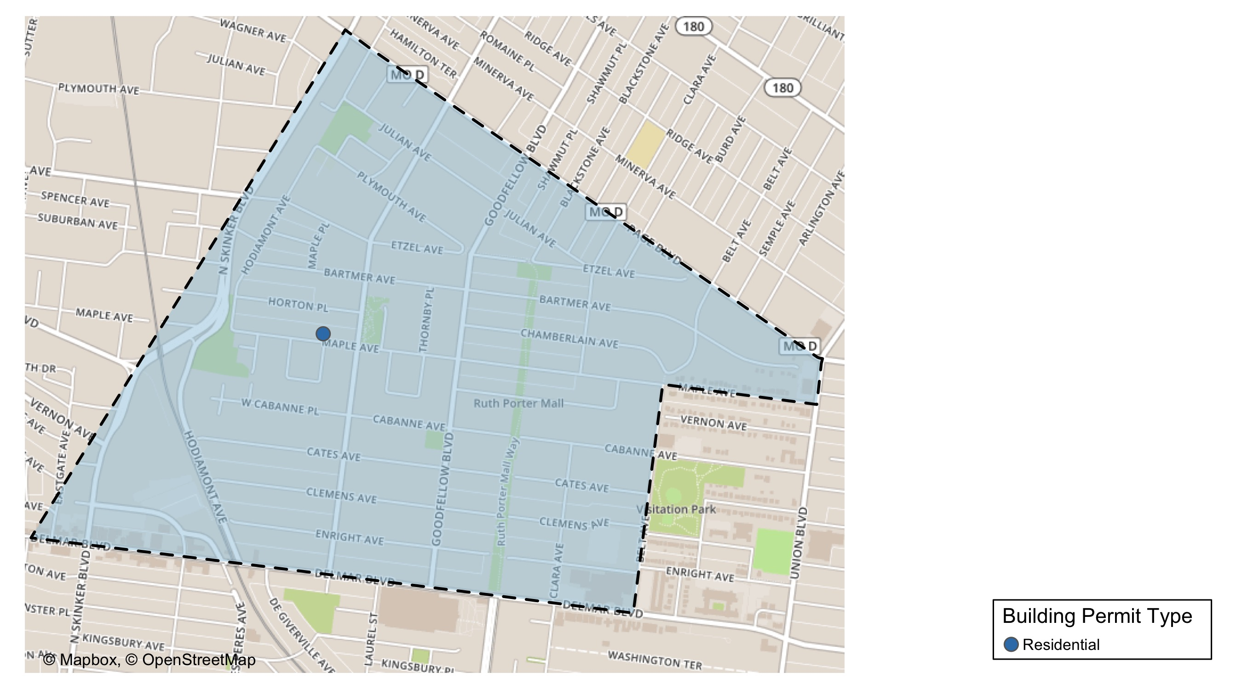
West End

Slide 31
West End
May 2020 | May 2020 | May 2020 | May 2020
Permit Use | Average Cost | # of Permits | Total Value of Permits
Commercial | $0 | 0 | $0
Industrial | $0 | 0 | $0
Institutional | $0 | 0 | $0
Residential | $5,423,125 | 2 | $10,846,250
Last 6 Months | Last 6 Months | Last 6 Months | Last 6 Months
Permit Use | Average Cost | # of Permits | Total Value of Permits
Commercial | $73,758 | 6 | $442,550
Industrial | $0 | 0 | $0
Institutional | $3,228,000 | 3 | $9,684,000
Residential | $431,353 | 32 | $13,803,283

Slide 32
West End Individual Permit Breakdown
Owner | New Use | Cost | Address
DELMAR DIVINE MASTER LANDLORD COMMER | Residential | $10,840,000 | 5535 DELMAR BLVD
MABS LLC | Residential | $6,250 | 5931 MAPLE AV

Slide 33
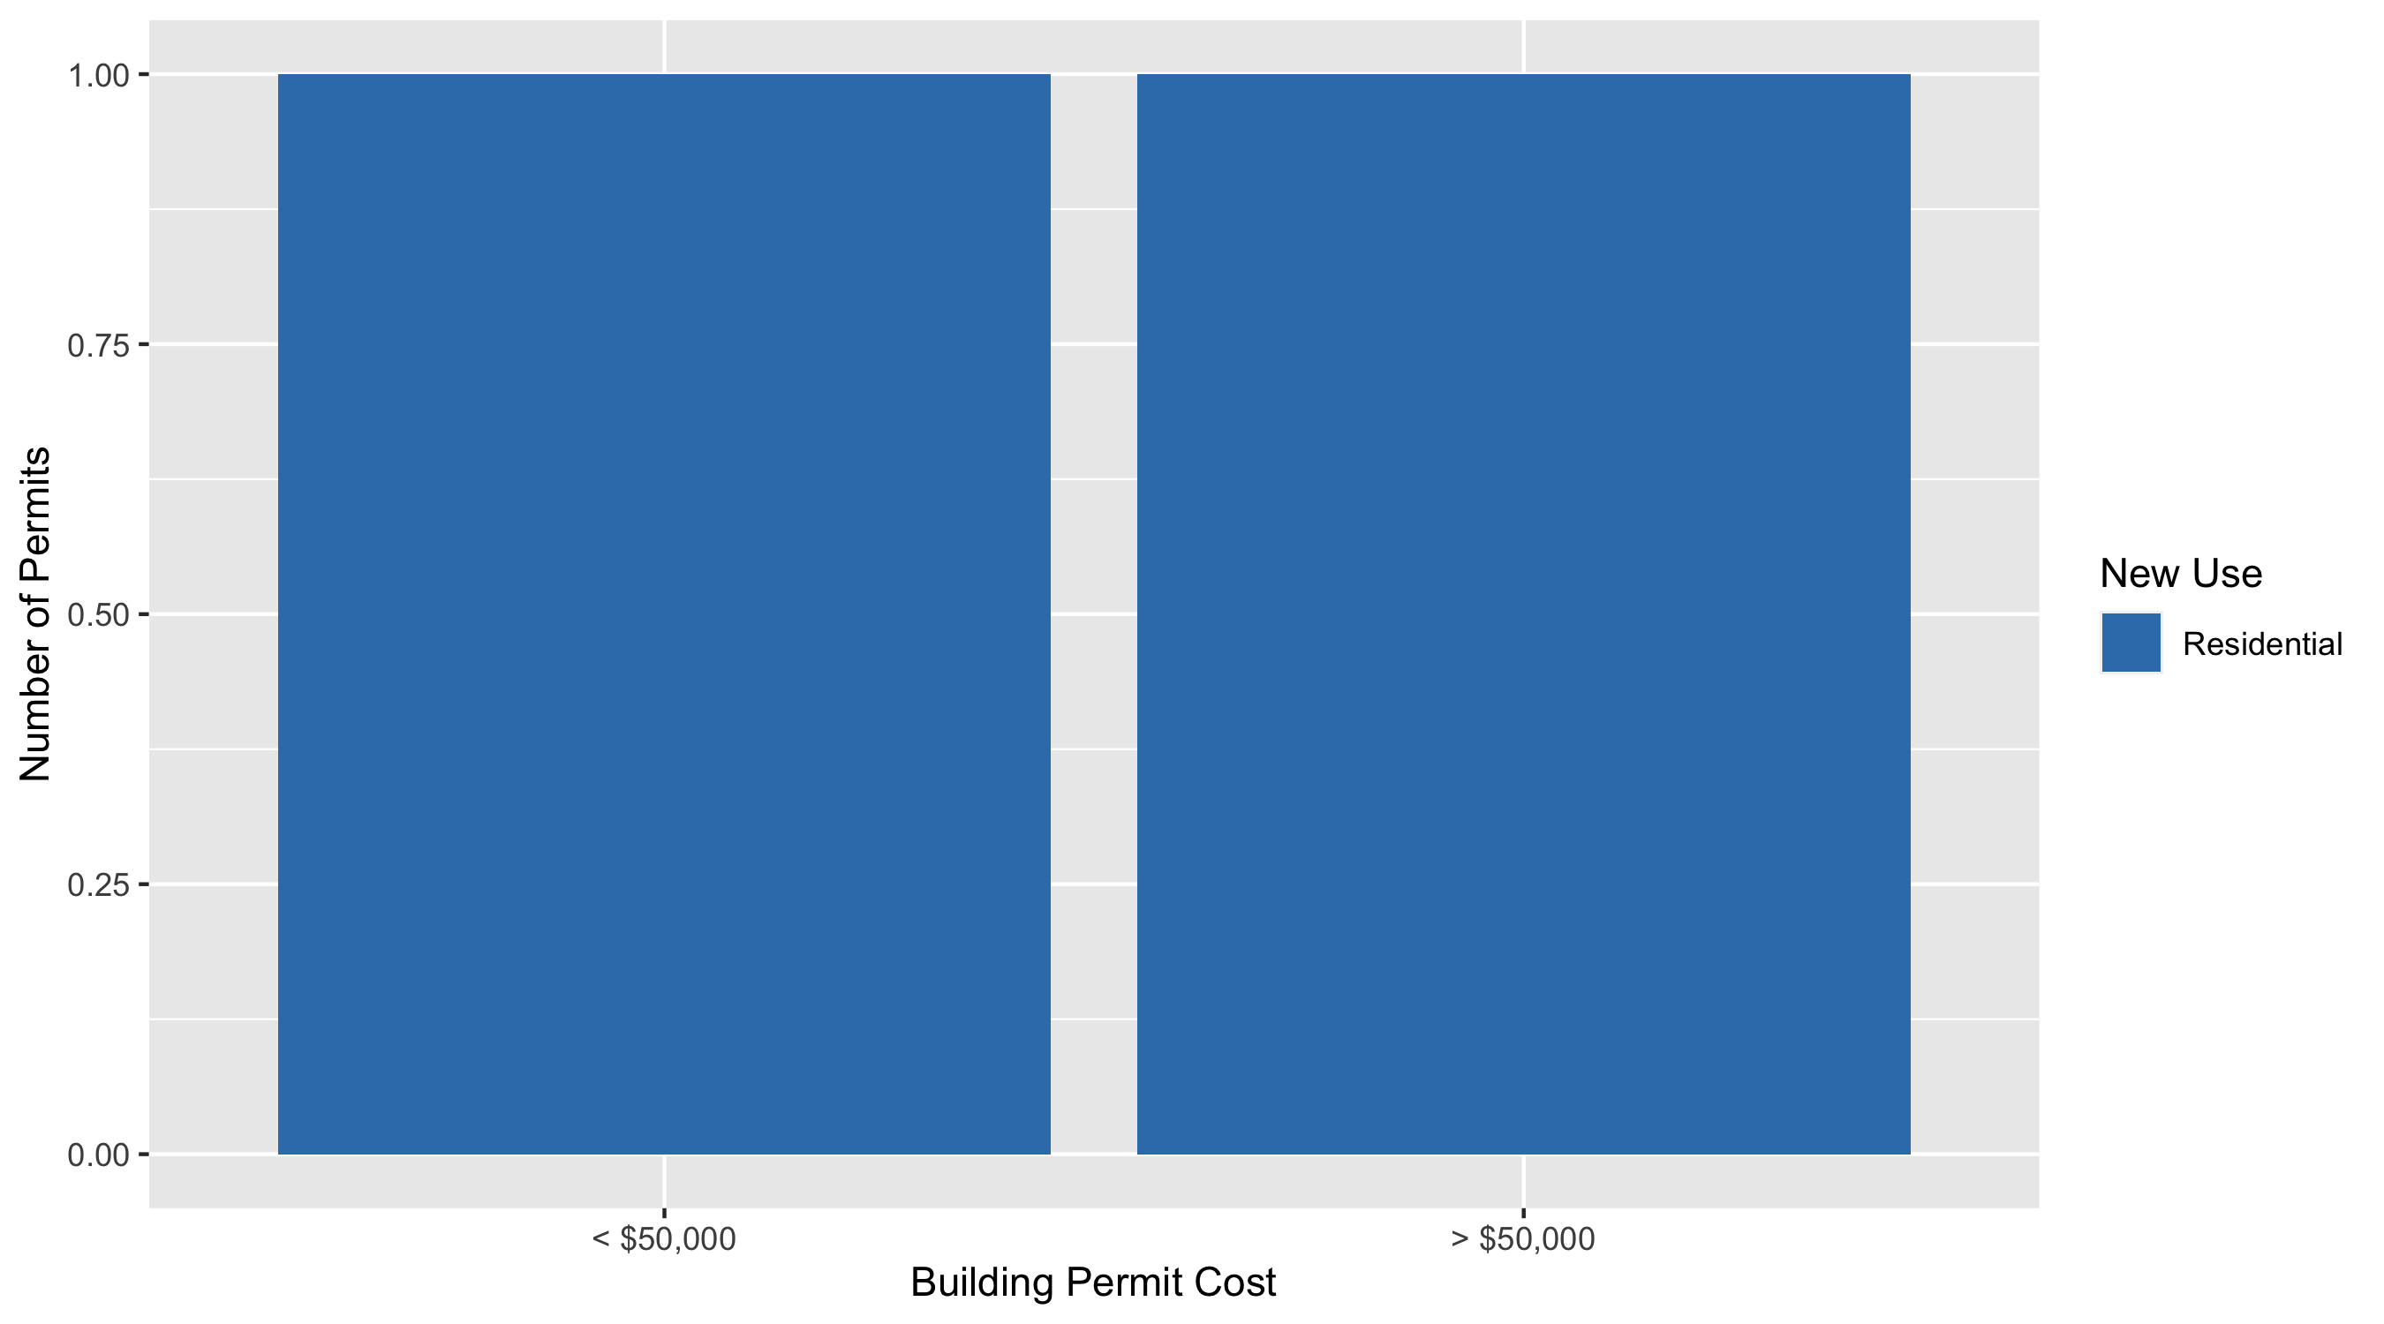
West End Permit Cost Breakdown

Slide 34
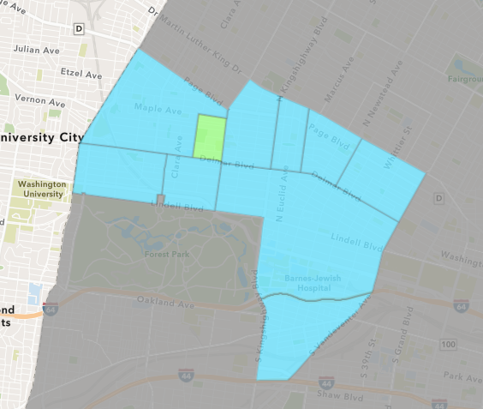
Visitation Park
May 2020 Neighborhood Cost Breakdown
Mean: $0
Median: NA
Range: $0 - $0

Slide 35
Visitation Park: Summary Notes
0 building permits in May 2020
0.00% change compared to May 2019 (0 total building permits)
$0: Average building permit cost in May 2020
0.00% change compared to May 2019 ($0)
1 total building permits in 2020
Infinite change YTD compared to this time in 2019 (0 total building permits)
$14,000: YTD average building permit cost in 2020
Infinite change YTD compared to this time in 2019 ($0)

Slide 36
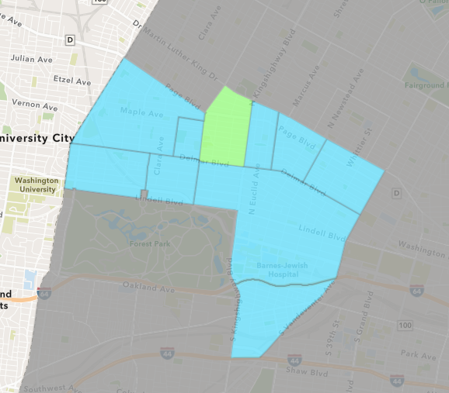
Academy
May 2020 Neighborhood Cost Breakdown
Mean: $3,200
Median: $3,200
Range: $3,200 - $3,200

Slide 37
Academy: Summary Notes
1 building permits in May 2020
Infinite change compared to May 2019 (0 total building permits)
$3,200: Average building permit cost in May 2020
Infinite change compared to May 2019 ($0)
14 total building permits in 2020
-12.50% change YTD compared to this time in 2019 (16 total building permits)
$76,225: YTD average building permit cost in 2020
19.90% change YTD compared to this time in 2019 ($63,575)

Slide 38
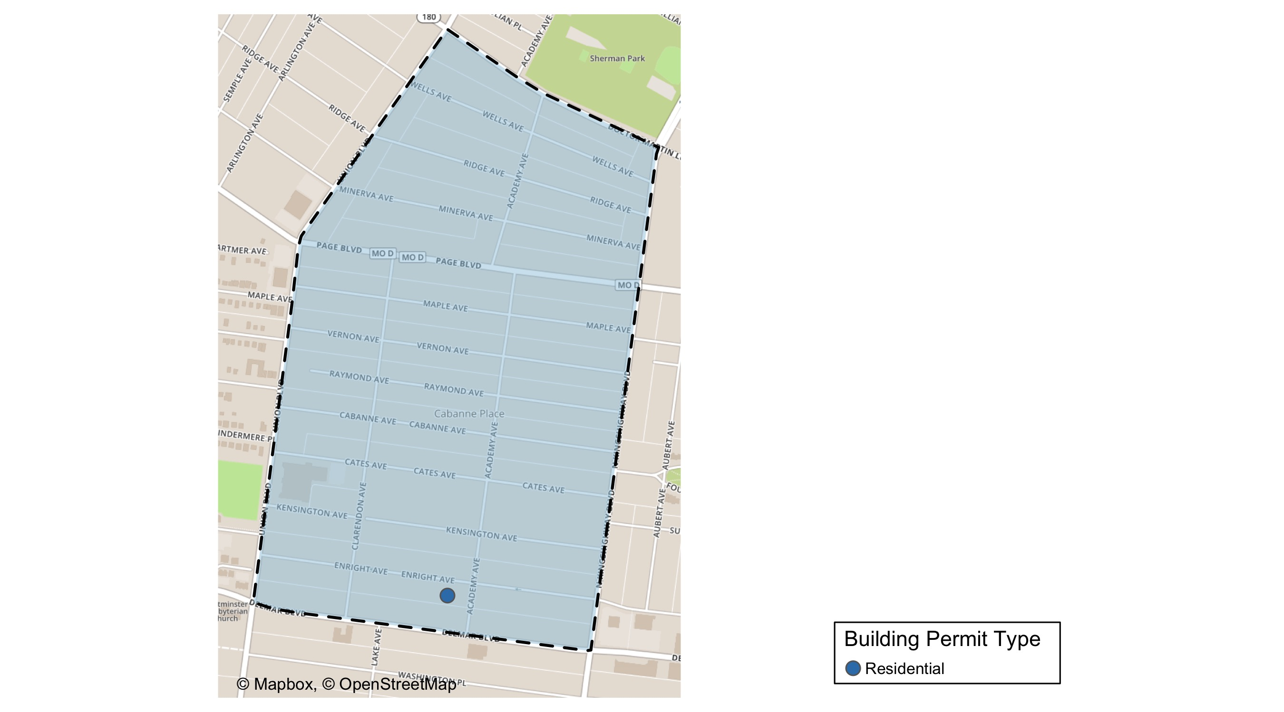
Academy

Slide 39
Academy
May 2020 | May 2020 | May 2020 | May 2020
Permit Use | Average Cost | # of Permits | Total Value of Permits
Commercial | $0 | 0 | $0
Industrial | $0 | 0 | $0
Institutional | $0 | 0 | $0
Residential | $3,200 | 1 | $3,200
Last 6 Months | Last 6 Months | Last 6 Months | Last 6 Months
Permit Use | Average Cost | # of Permits | Total Value of Permits
Commercial | $0 | 0 | $0
Industrial | $0 | 0 | $0
Institutional | $100,000 | 1 | $100,000
Residential | $75,353 | 16 | $1,205,650

Slide 40
Academy Individual Permit Breakdown
Owner | New Use | Cost | Address
MDE PROPERTIES LLC | Residential | $3,200 | 5166 ENRIGHT AV

Slide 41
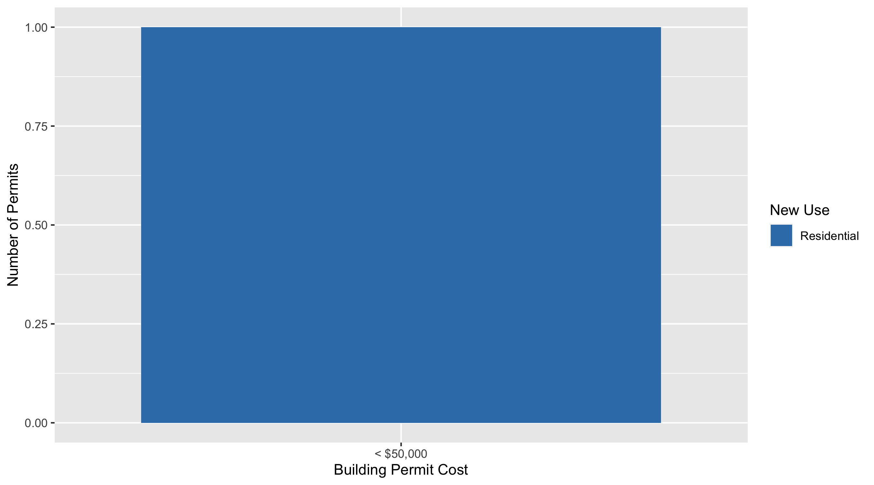
Academy Permit Cost Breakdown

Slide 42
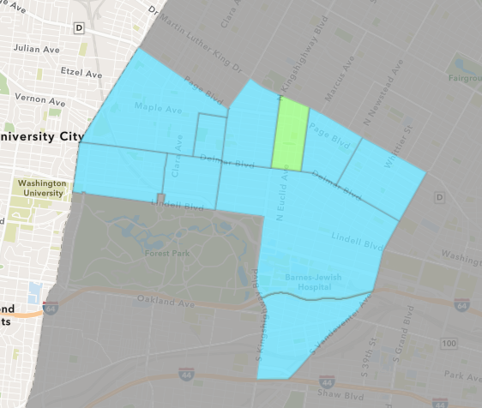
Fountain Park
May 2020 Neighborhood Cost Breakdown
Mean: $10,500
Median: $10,500
Range: $10,500 - $10,500

Slide 43
Fountain Park: Summary Notes
1 building permits in May 2020
Infinite change compared to May 2019 (0 total building permits)
$10,500: Average building permit cost in May 2020
Infinite change compared to May 2019 ($0)
5 total building permits in 2020
150.00% change YTD compared to this time in 2019 (2 total building permits)
$62,700: YTD average building permit cost in 2020
8260.00% change YTD compared to this time in 2019 ($750)

Slide 44
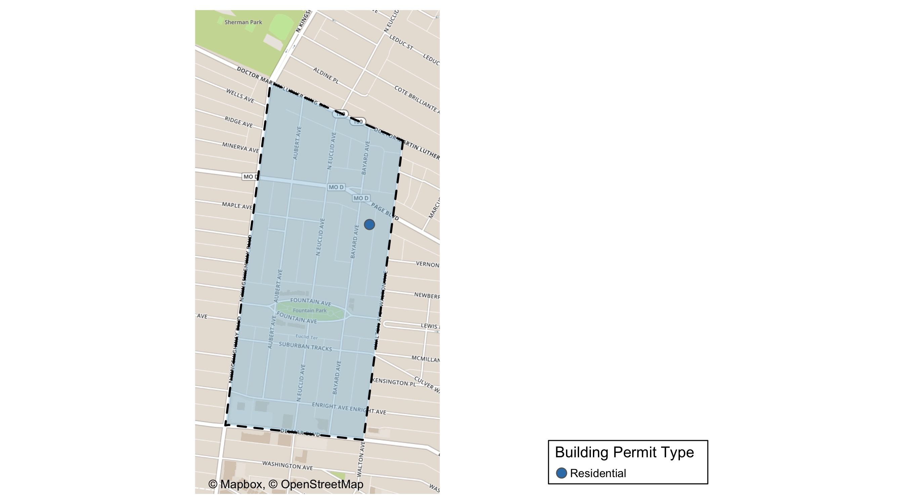
Fountain Park

Slide 45
Fountain Park
May 2020 | May 2020 | May 2020 | May 2020
Permit Use | Average Cost | # of Permits | Total Value of Permits
Commercial | $0 | 0 | $0
Industrial | $0 | 0 | $0
Institutional | $0 | 0 | $0
Residential | $10,500 | 1 | $10,500
Last 6 Months | Last 6 Months | Last 6 Months | Last 6 Months
Permit Use | Average Cost | # of Permits | Total Value of Permits
Commercial | $0 | 0 | $0
Industrial | $0 | 0 | $0
Institutional | $0 | 0 | $0
Residential | $62,700 | 5 | $313,500

Slide 46
Fountain Park Individual Permit Breakdown
Owner | New Use | Cost | Address
BOOKER, RICHARD JR & | Residential | $10,500 | 1234 BAYARD AV

Slide 47
Fountain Park Permit Cost Breakdown

Slide 48
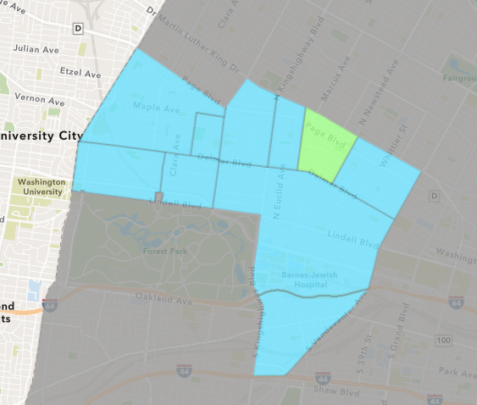
Lewis Place
May 2020 Neighborhood Cost Breakdown
Mean: $0
Median: NA
Range: $0 - $0

Slide 49
Lewis Place: Summary Notes
0 building permits in May 2020
-100.00% change compared to May 2019 (1 total building permits)
$0: Average building permit cost in May 2020
-100.00% change compared to May 2019 ($15,000)
4 total building permits in 2020
-33.33% change YTD compared to this time in 2019 (6 total building permits)
$800: YTD average building permit cost in 2020
-88.32% change YTD compared to this time in 2019 ($6,850)

Slide 50
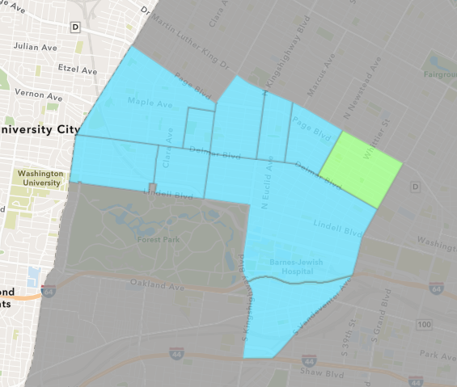
Vandeventer
May 2020 Neighborhood Cost Breakdown
Mean: $1,350
Median: $1,350
Range: $500 - $2,200

Slide 51
Vandeventer: Summary Notes
2 building permits in May 2020
-66.67% change compared to May 2019 (6 total building permits)
$1,350: Average building permit cost in May 2020
-92.77% change compared to May 2019 ($18,667)
6 total building permits in 2020
-64.71% change YTD compared to this time in 2019 (17 total building permits)
$40,013: YTD average building permit cost in 2020
-77.56% change YTD compared to this time in 2019 ($178,321)

Slide 52
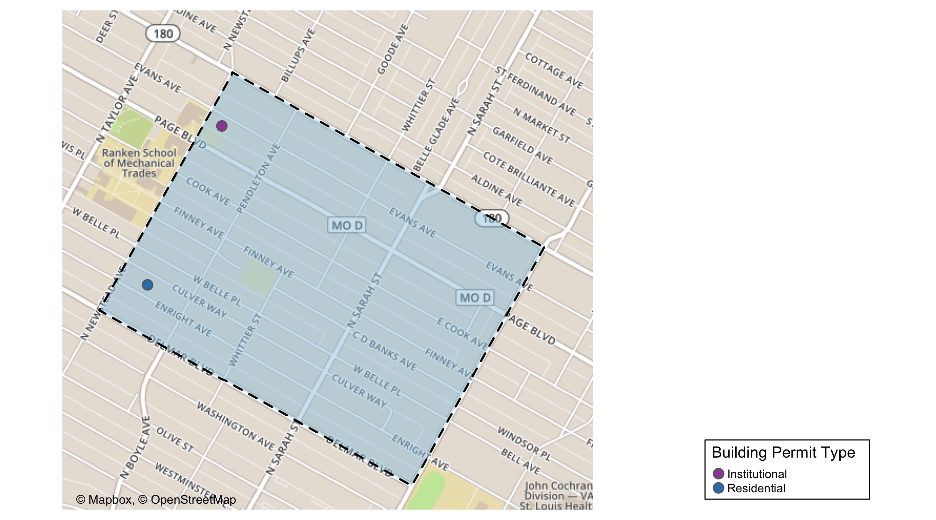
Vandeventer

Slide 53
Vandeventer
May 2020 | May 2020 | May 2020 | May 2020
Permit Use | Average Cost | # of Permits | Total Value of Permits
Commercial | $0 | 0 | $0
Industrial | $0 | 0 | $0
Institutional | $500 | 1 | $500
Residential | $2,200 | 1 | $2,200
Last 6 Months | Last 6 Months | Last 6 Months | Last 6 Months
Permit Use | Average Cost | # of Permits | Total Value of Permits
Commercial | $0 | 0 | $0
Industrial | $55,000 | 1 | $55,000
Institutional | $12,073 | 2 | $24,146
Residential | $56,686 | 5 | $283,431

Slide 54
Vandeventer Individual Permit Breakdown
Owner | New Use | Cost | Address
FLOWERS, DEAUN A | Residential | $2,200 | 915 PENDLETON AV
PATTERSON, SHARON E & NICHOLE | Institutional | $500 | 1318 N NEWSTEAD AV

Slide 55
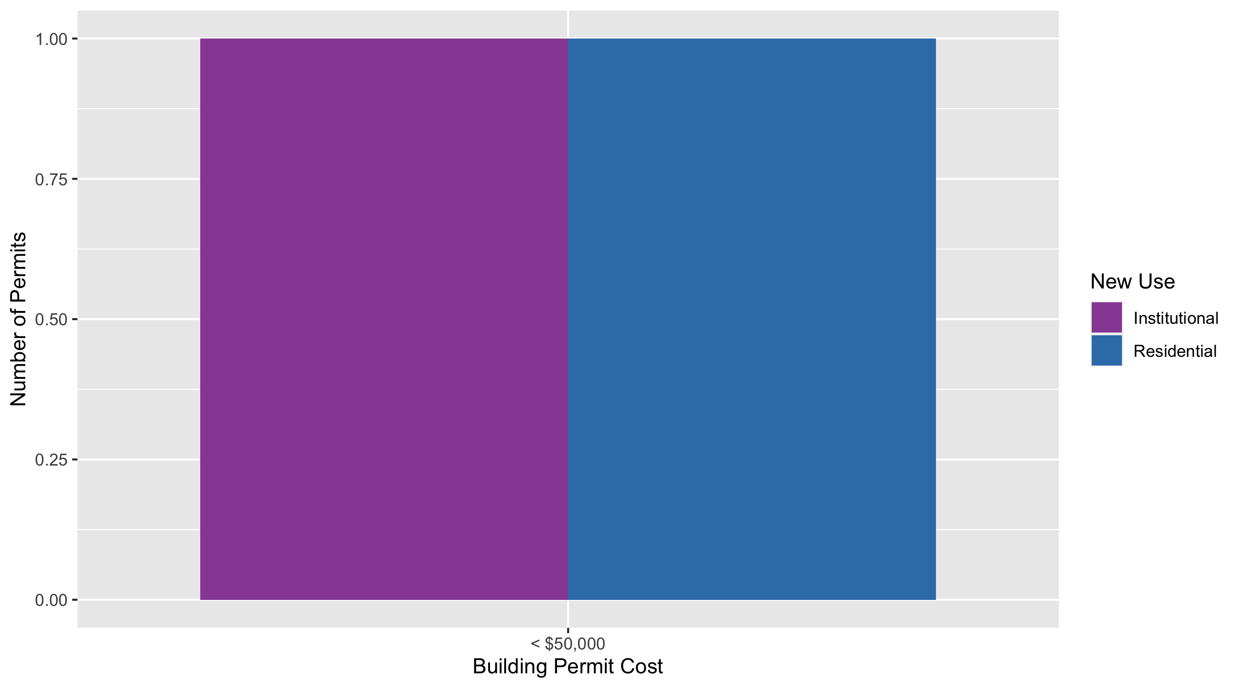
Vandeventer Permit Cost Breakdown

Slide 56
Additional Notes
Data retreived from https://www.stlouis-mo.gov/data/
Building permits with a cost of $0 were dropped
Building permits that were cancelled were dropped
Infinite change indicates 0 permits in the current or previous time period/comparison month so there was a overall increase or decrease

